Slide 1
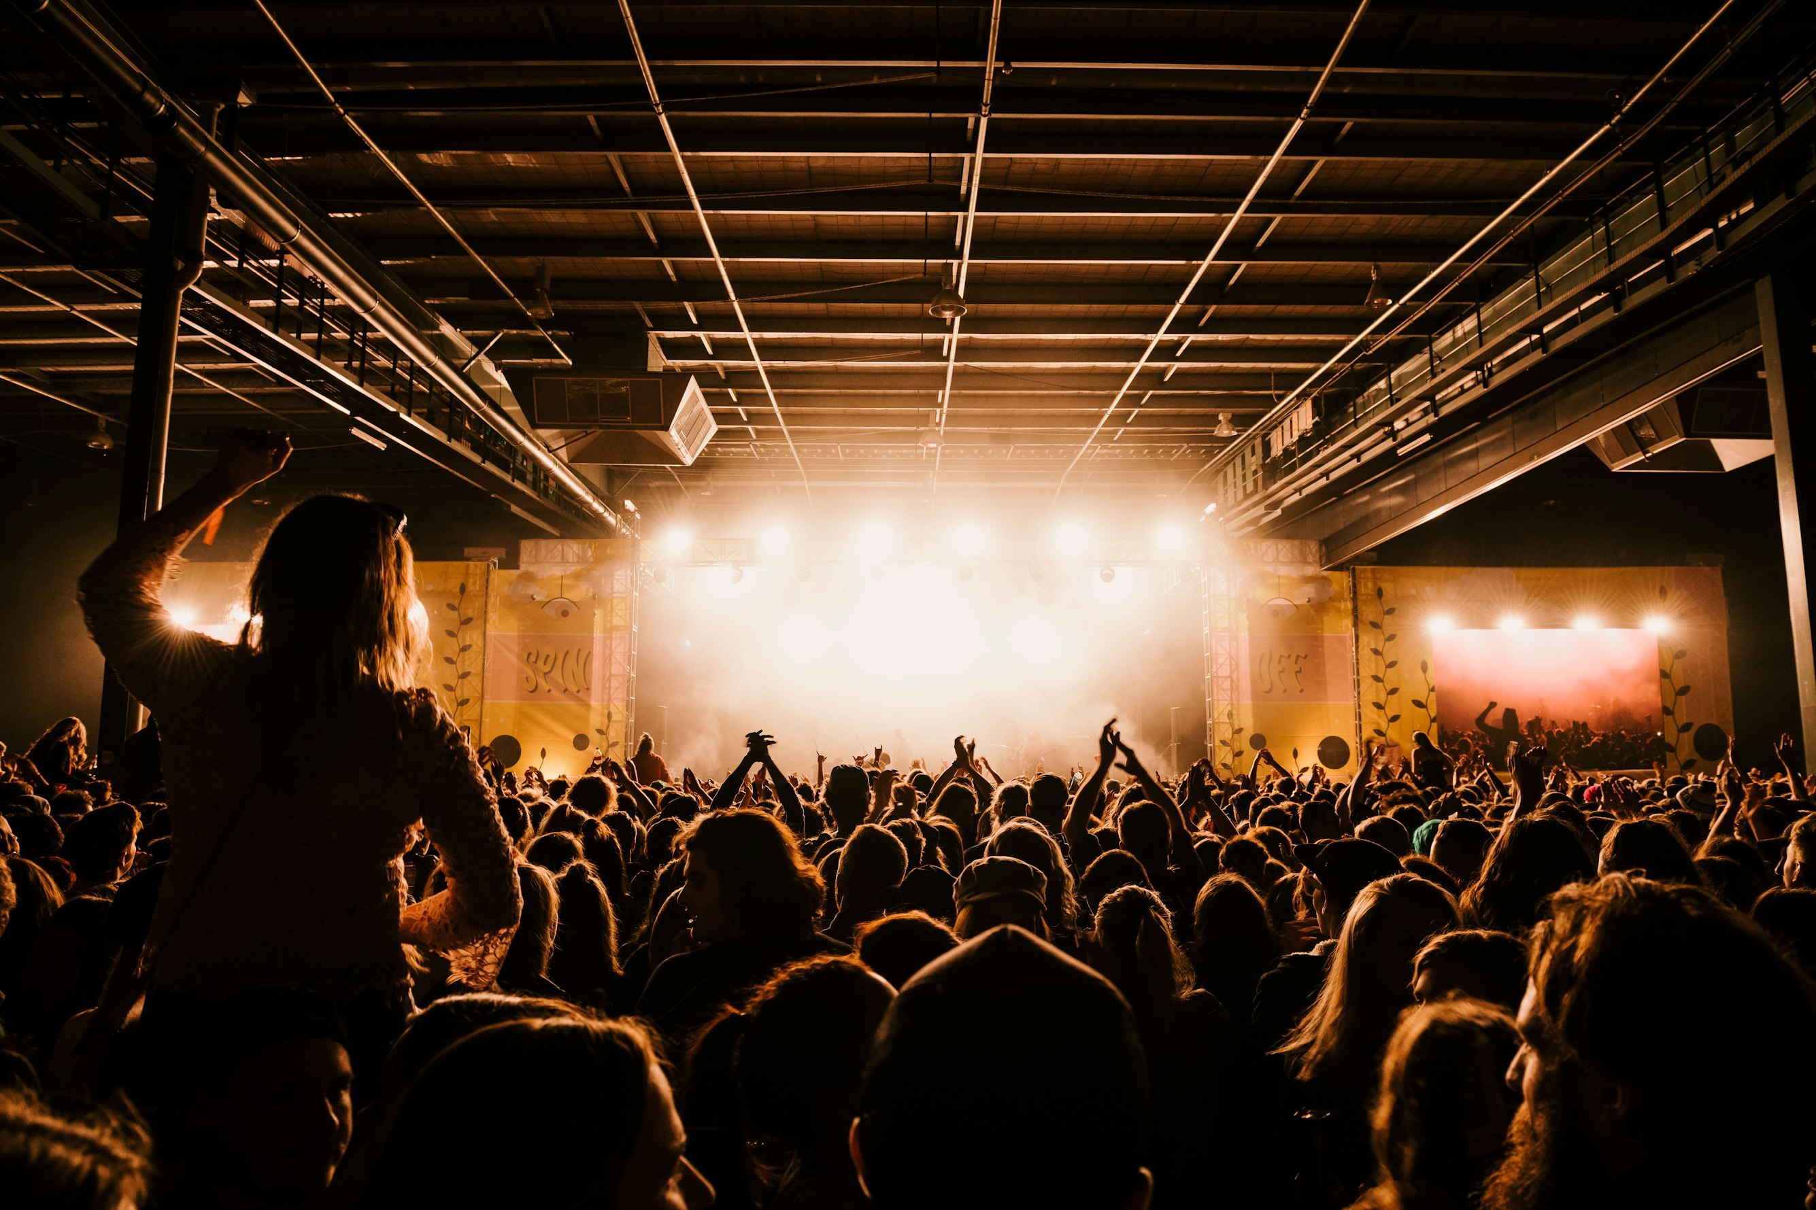
1. 目標
Notes:
https://unsplash.com/photos/photo-of-a-lighted-concert-74kShnX5zZI

Slide 2

2. 阻礙
Notes:
https://unsplash.com/photos/brown-and-white-clocks-FlHdnPO6dlw

Slide 3
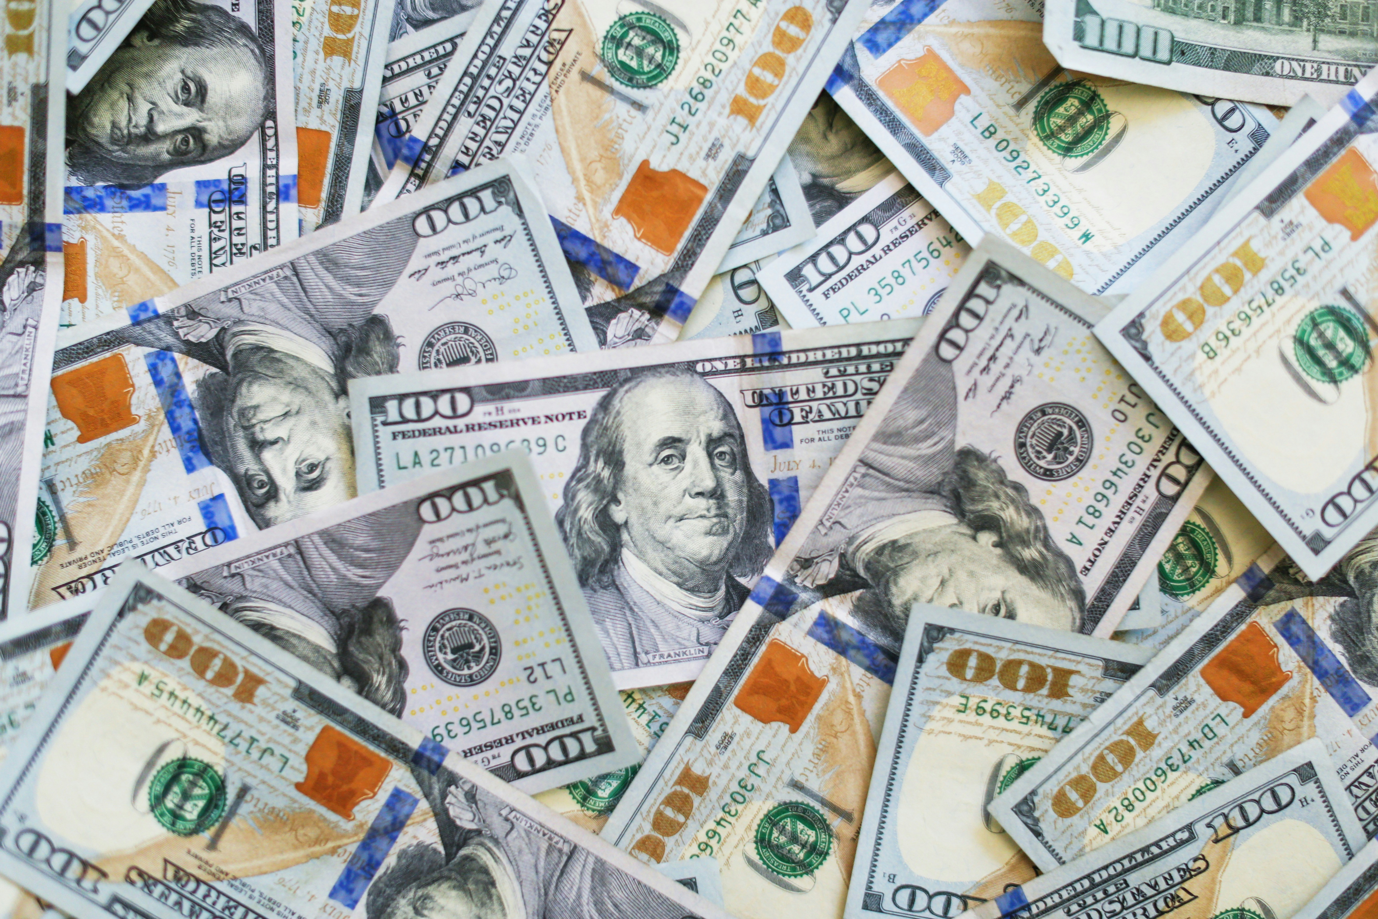
2. 阻礙
Notes:
https://unsplash.com/photos/100-us-dollar-bill-BRl69uNXr7g

Slide 4
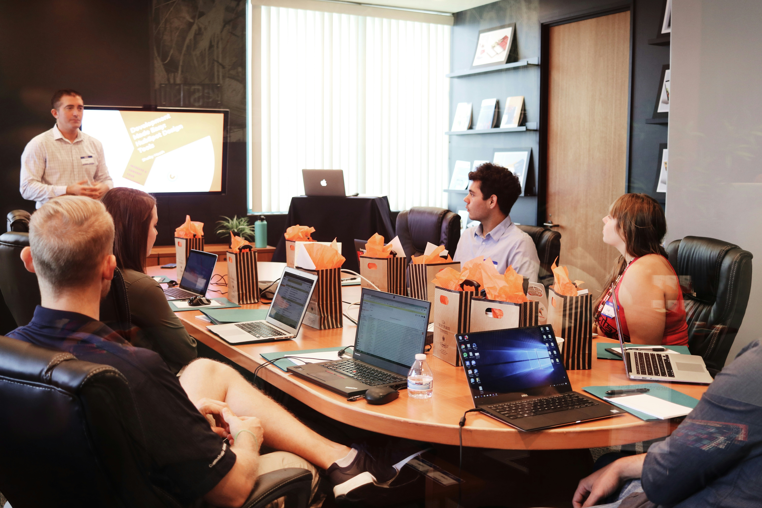
2. 阻礙
Notes:
https://unsplash.com/photos/man-standing-in-front-of-people-sitting-beside-table-with-laptop-computers-gMsnXqILjp4

Slide 5
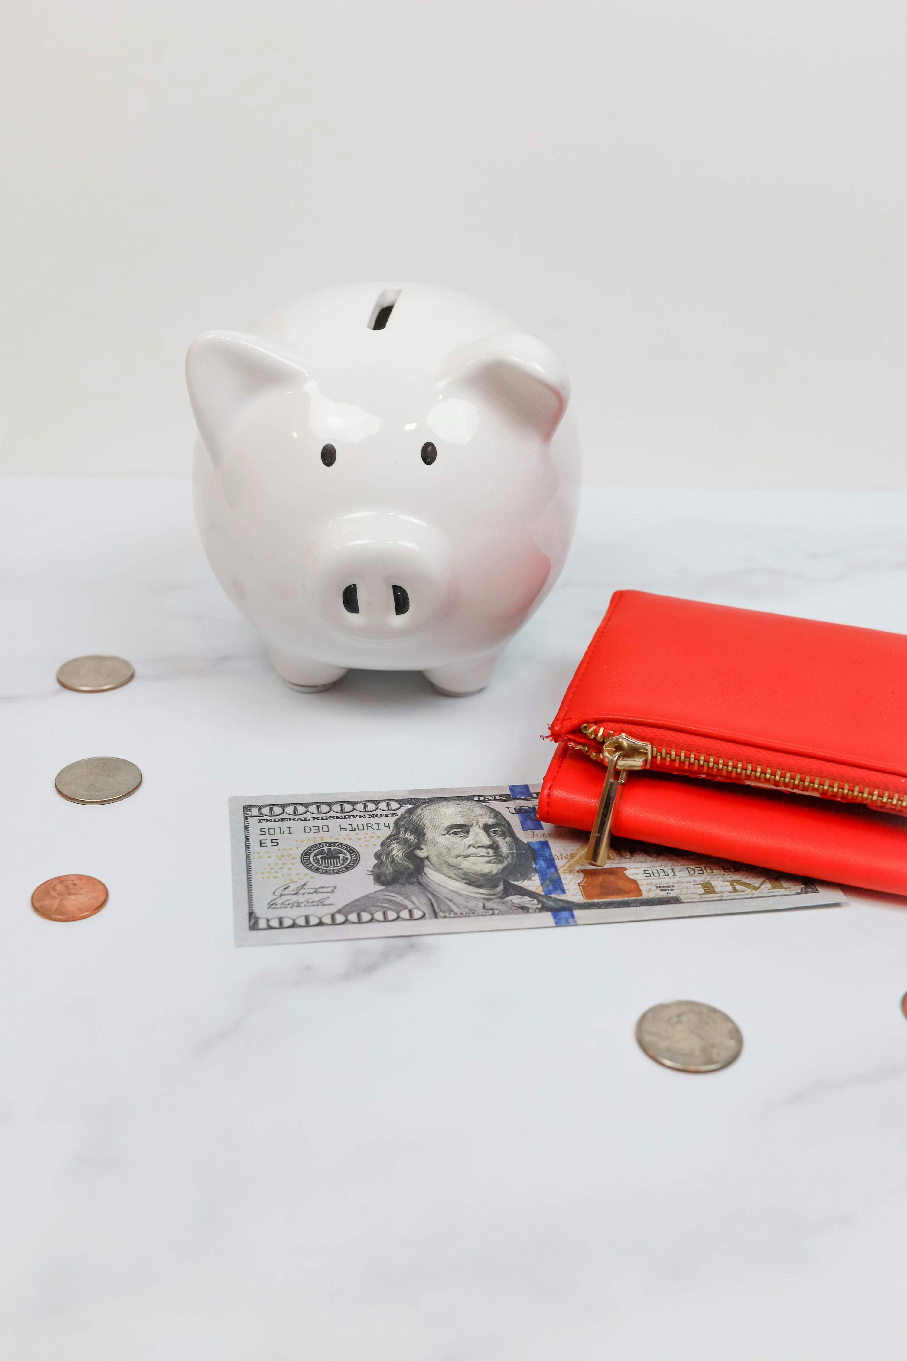
3. 努力
Notes:
https://unsplash.com/photos/a-piggy-bank-and-coins-Rel6bBC6AuA

Slide 6
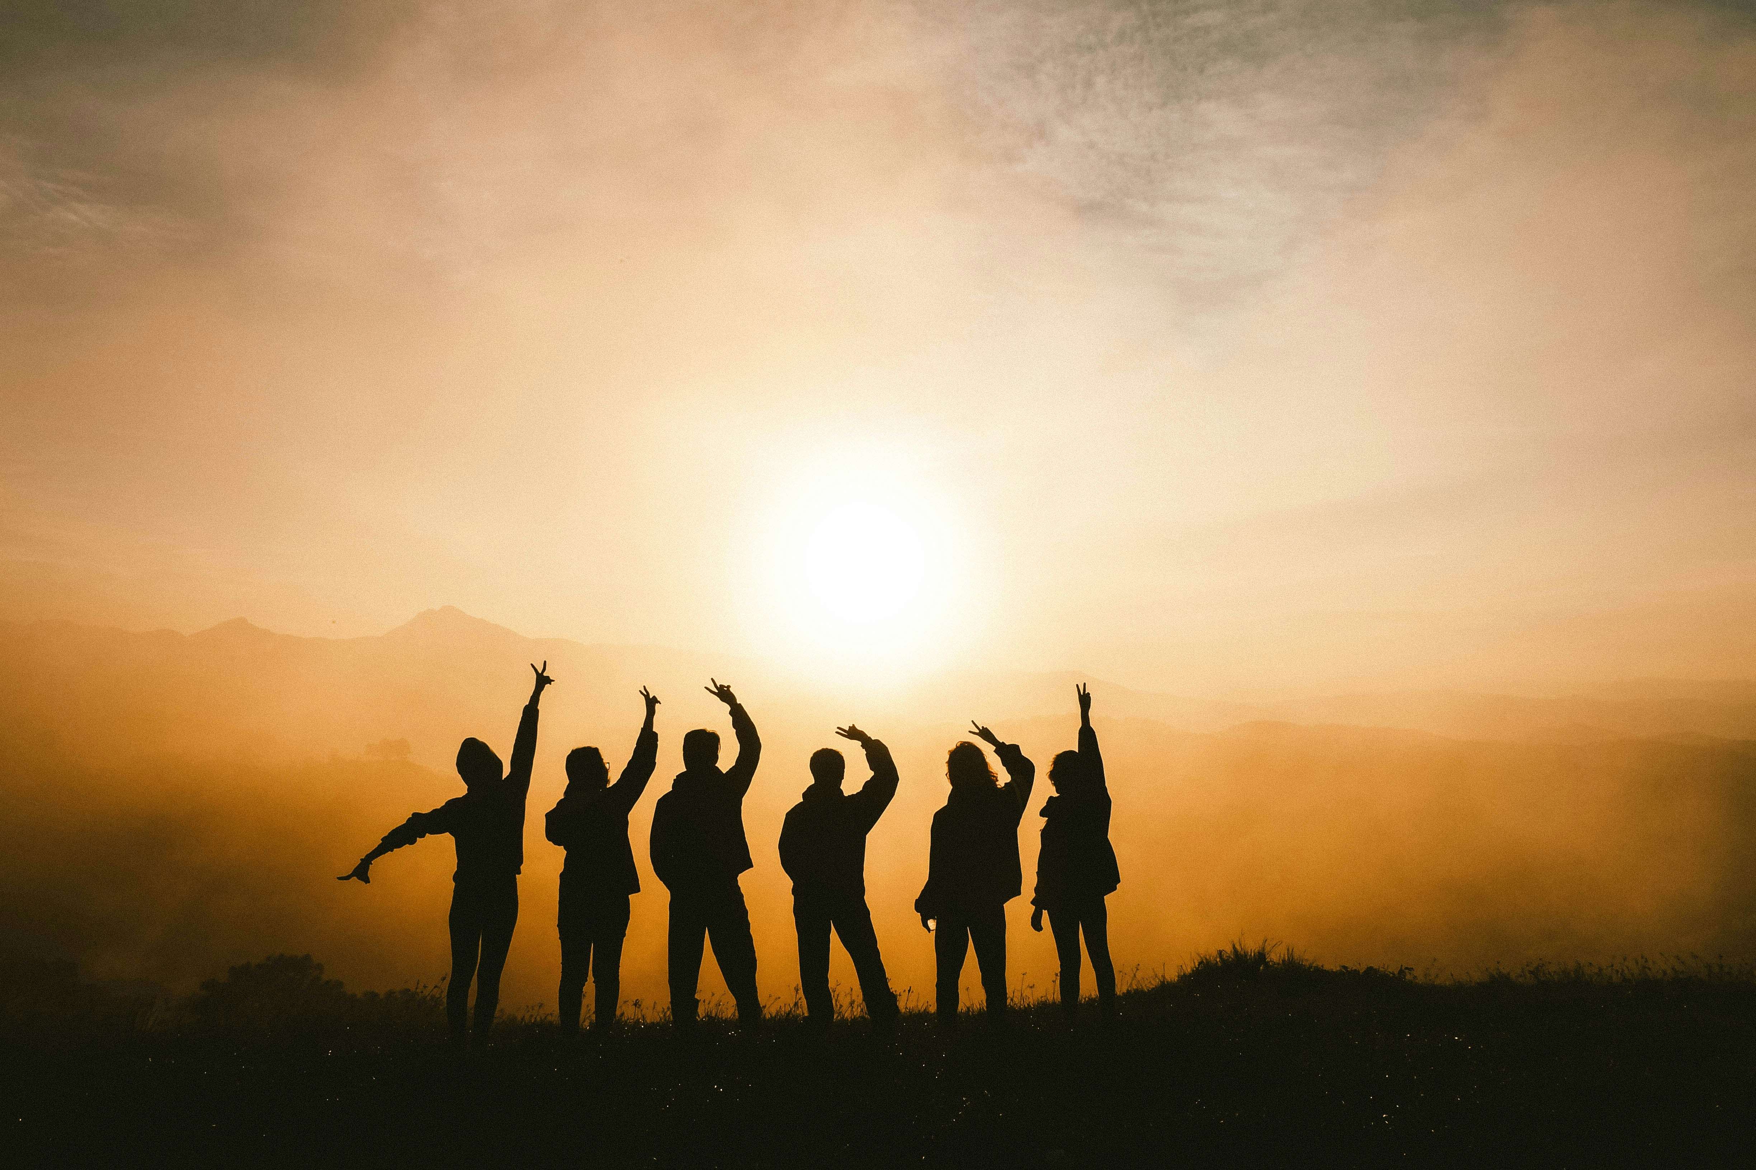
3. 努力
Notes:
https://unsplash.com/photos/silhouette-photo-of-six-persons-on-top-of-mountain-Sj0iMtq_Z4w

Slide 7
4.結果
Notes:
https://unsplash.com/photos/man-in-white-dress-shirt-sitting-beside-woman-in-black-long-sleeve-shirt-376KN_ISplE

Slide 8

5.意外
Notes:
https://unsplash.com/photos/macbook-air-on-table-r02wxT3-PYw

Slide 9

6. 轉彎
Notes:
https://unsplash.com/photos/man-wearing-white-top-using-macbook-1K9T5YiZ2WU

Slide 10

7.結局
Notes:
https://unsplash.com/photos/people-holding-snifter-glasses-JKMnm3CIncw

